Slide 1

Real Time Anomaly Detection in CCTV Surveillance
Submitted by:-
Avdhesh Chaudhary(02315002719)
Amar Sinha(04415002719)
Chirag Aggarwal(04615002719)
Under the Supervision of
Mr. Vikrant Shokeen

Slide 2
Project Overview
In this project we seek to improvise or make surveillance system more advanced and automated. For this we need to show in which frame and which parts of CCTV footage contain abnormal or suspicious activity . To achieve aforesaid we will be using two different neural networks CNN and RNN.
We will be using InceptionV3 by Google - a pre-trained model to apply the technique of transfer learning. The output of the RNN system is used to perform real-time surveillance on the CCTV cameras of different organizations to avoid and detect any suspicious activity. Hence, the time complexity is reduced to a great extent.

Slide 3
Crime Dataset
The UCF-Crime dataset is a large-scale dataset of 128 hours of videos. It consists of 1900 long and untrimmed real-world surveillance videos, with 13 realistic anomalies including Abuse, Arrest, Arson, Assault, Road Accident, Burglary, Explosion, Fighting, Robbery, Shooting, Stealing, Shoplifting, and Vandalism.

Slide 4
Abuse
Arrest
Arson
Assault
Burglary
Explosion

Slide 5
Fighting
Road Accident
robbery
Shooting
Shoplifting
Stealing

Slide 6
Vandalism
Normal

Slide 7
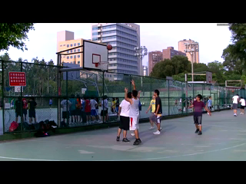

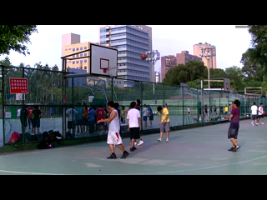
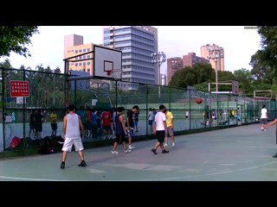
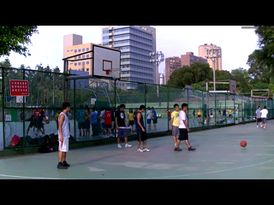
Video to Frame Conversion

Slide 8
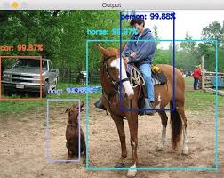
Object detection using inception V3

Slide 9
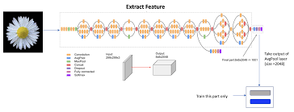
Transfer learning from Inception V3

Slide 10
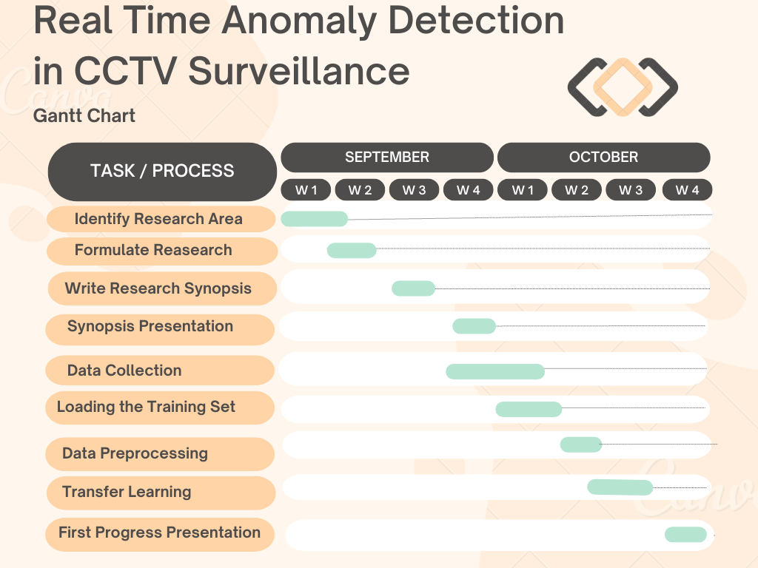

Slide 11
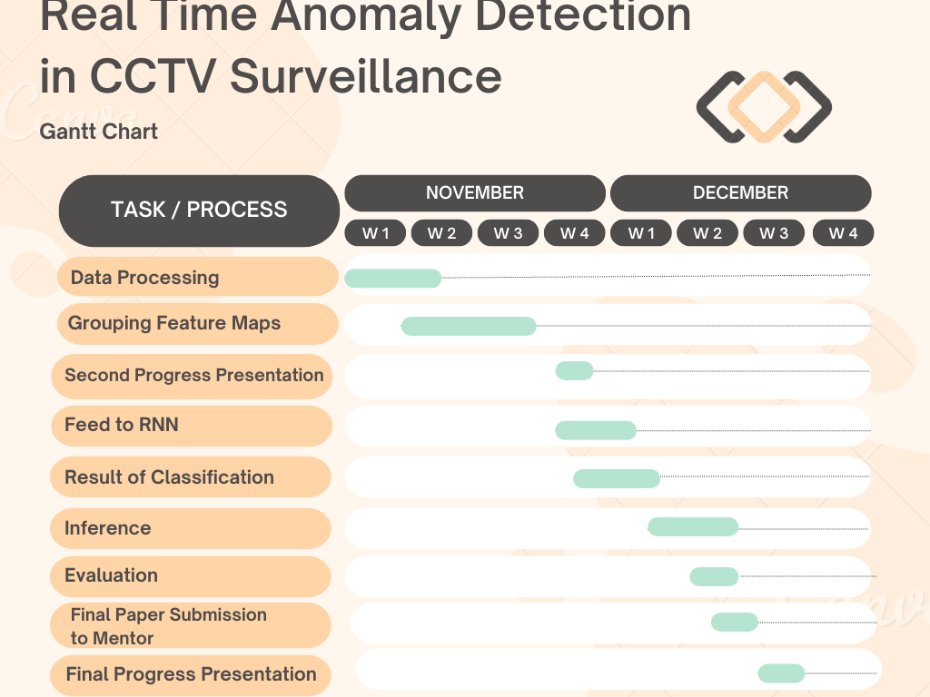

Slide 12
Thank You

